Slide 1



Age versus status:
What do welfare states really do?
Robert I. Gal (HDRI, TARKI, CUB)
Marton Medgyesi (TARKI, HAS CSS IS)
Pieter Vanhuysse (SDU)
August 6, 2020
NTA 2020 – Online conference

Slide 2
Motivation:
The welfare state is most frequently evaluated by its effectiveness and efficiency in alleviating poverty or mitigating inequalities.
Analysis repeatedly finds benefits being poorly targeted or even producing Matthew effects.
However, the various headings of welfare spending have clear age-profiles: beneficiaries are typically in inactive age, contributors are typically of working-age. The welfare state seems to be an inter-age project.
Research:
We compare the relative importance of age and socio-economic status (SES) in explaining the access to welfare benefits and the contribution to its funding.

Slide 3
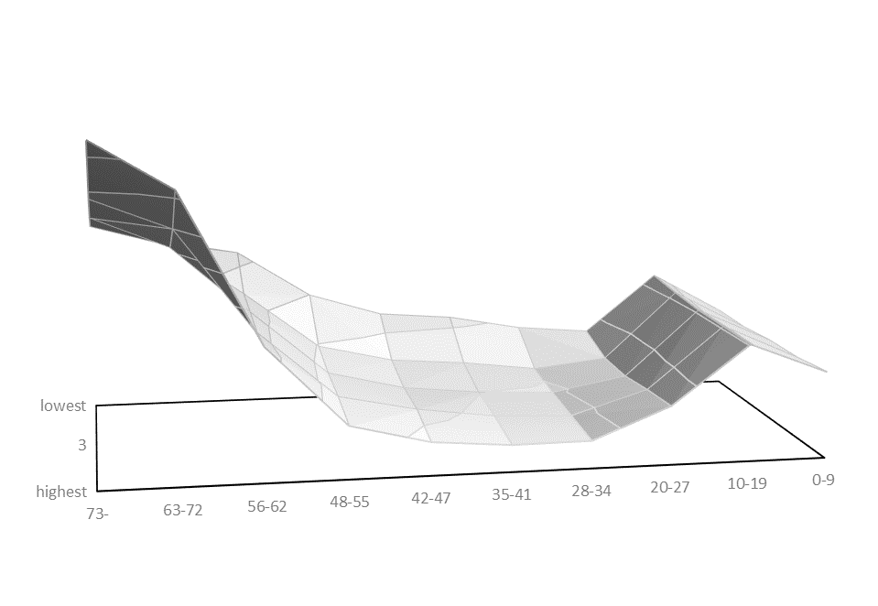
Per capita welfare spending (cash and in-kind) by age and SES in the European Union, 2010
Simple average of 22 Member States; national values are rescaled based on the average labor income of 30-49-year-olds.
For better visibility the image is rotated.

Slide 4
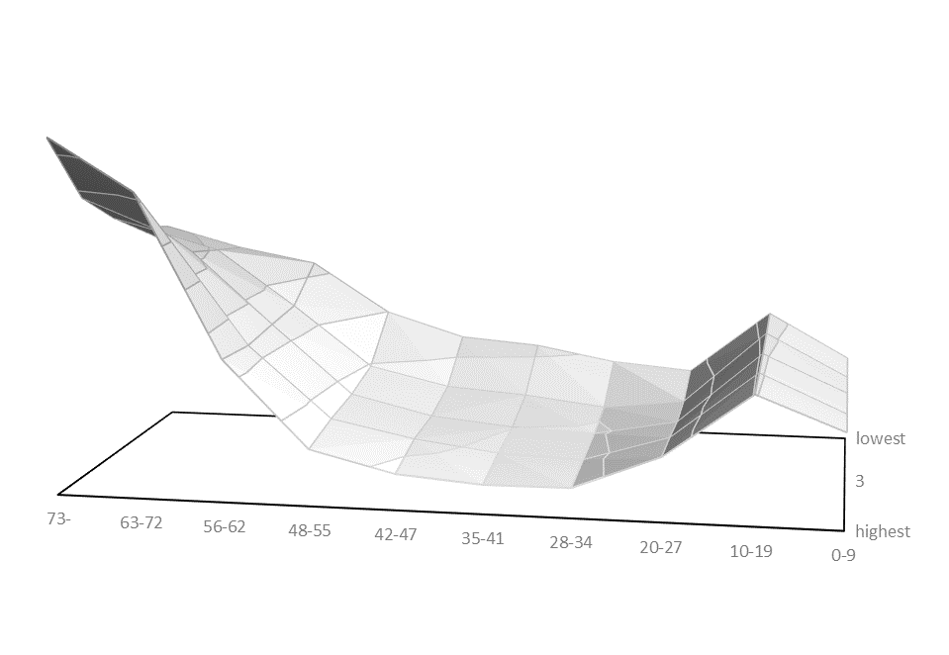

Slide 5
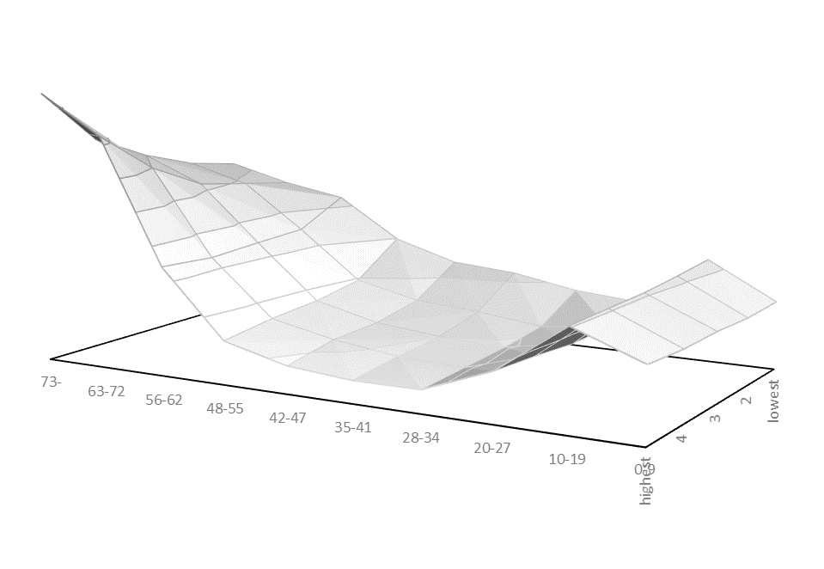

Slide 6
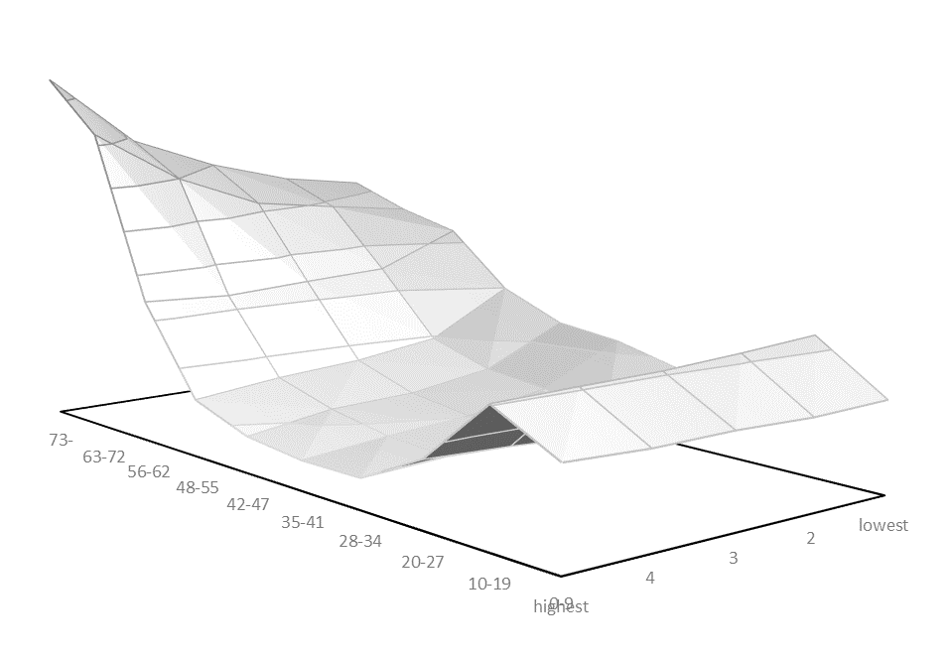

Slide 7
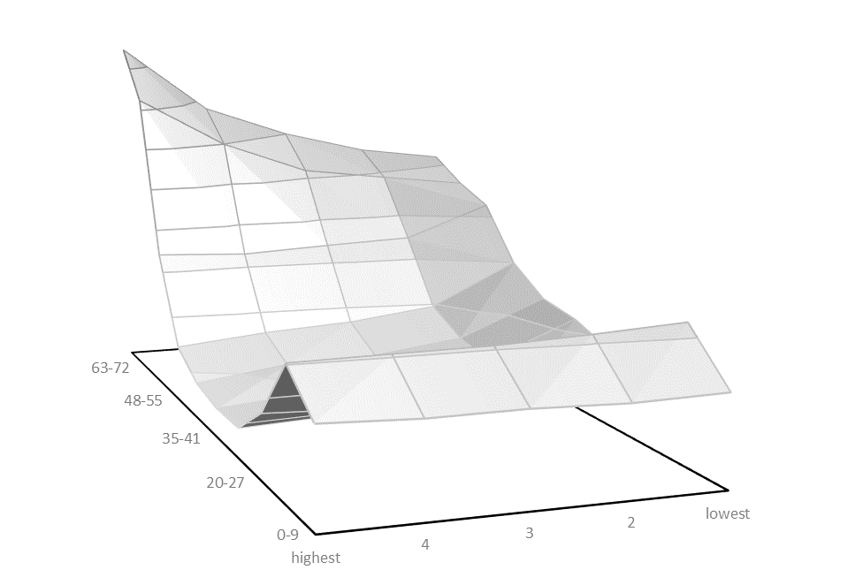

Slide 8
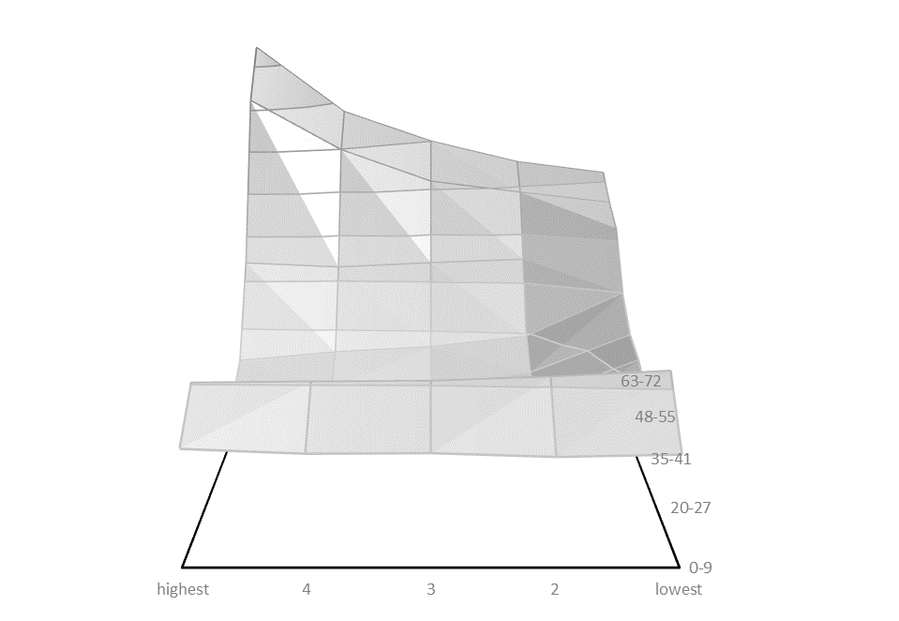

Slide 9
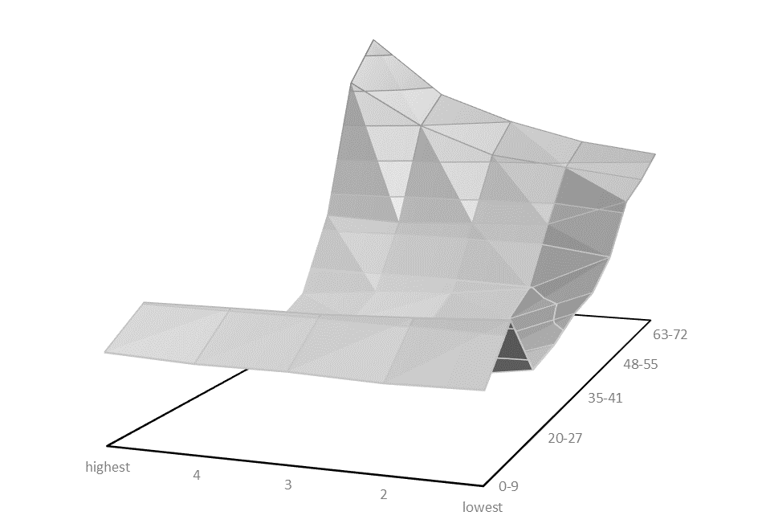

Slide 10
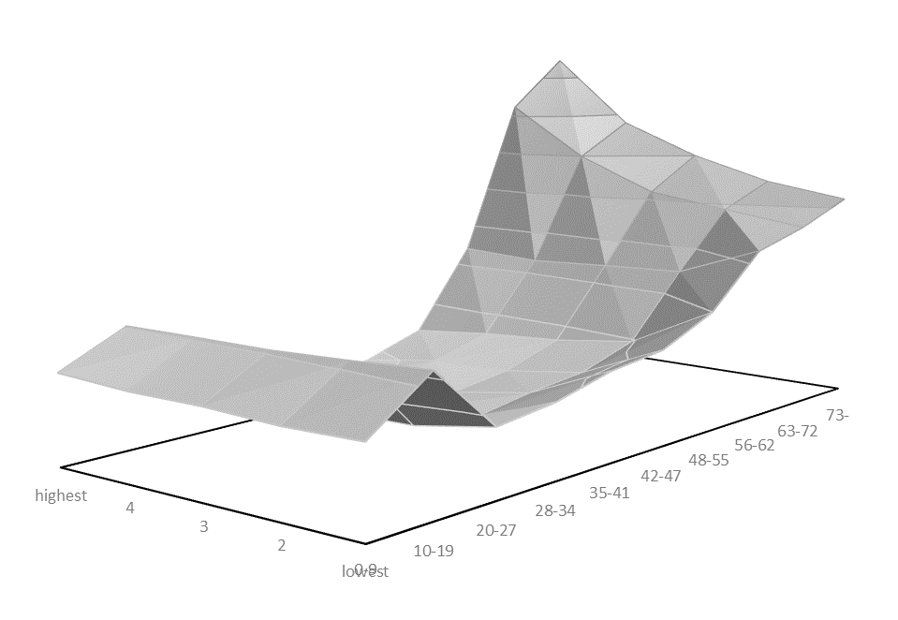

Slide 11
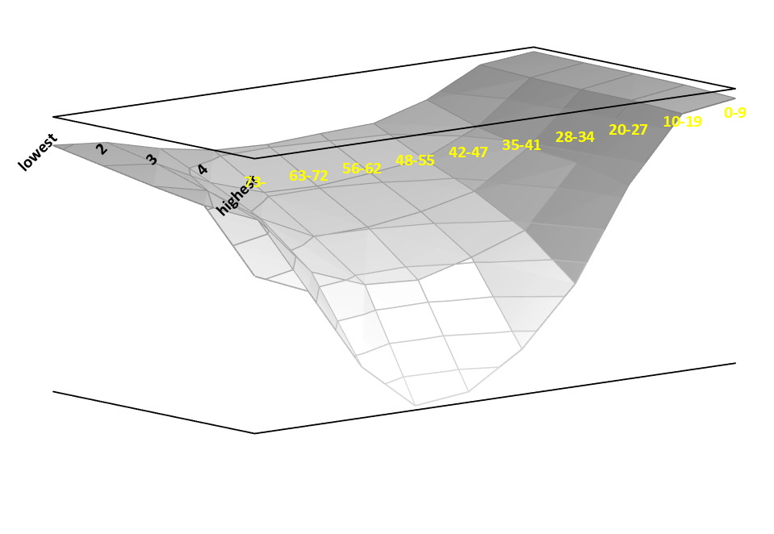
Per capita taxes funding welfare expenses by age and SES in the European Union, 2010
Source and notes as above.

Slide 12
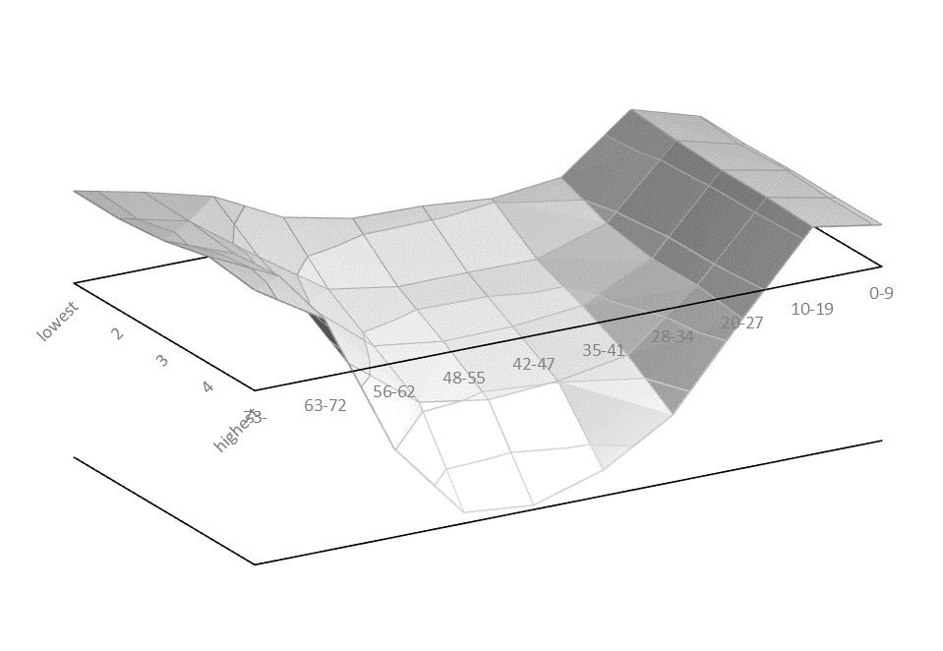
Per capita net benefits by age and SES in the European Union, 2010
Source and notes as above.

Slide 13
Regression: an explanatory variable is more important than another if
its coefficients are larger (causal or theoretical importance)
it explains more of the total variation of the dependent variable (dispersion importance)
The model:
Y = α + ∑_{i}β_{Ai}Age_{i} + ∑_{j}β_{Ij}Status_{j}+ ε,
where Age_{i} and Status_{j} are dummy variables of age and SES (i,j = 2,..,10) and the βs are regression coefficients

Slide 14
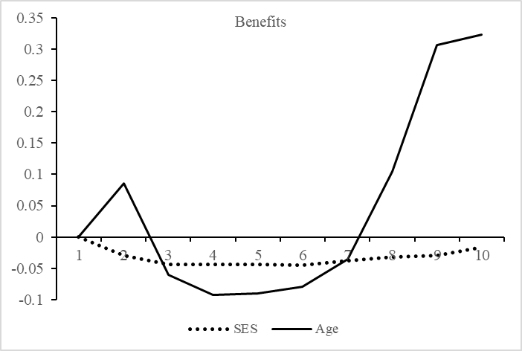
Coefficients of age and SES groups – Benefit model
(reference category, age=0-9, SES=lowest status group)

Slide 15
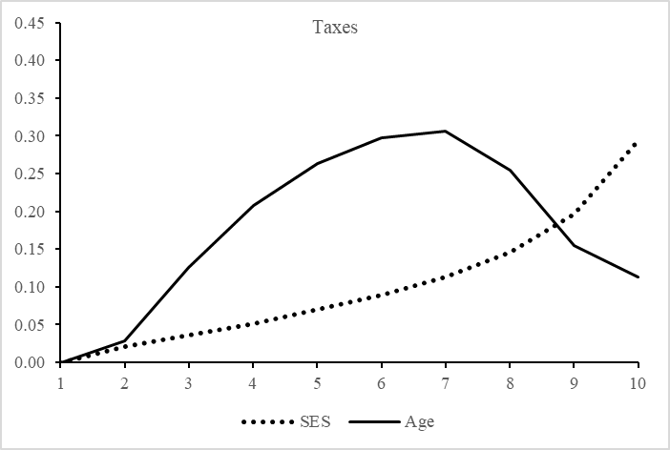
Coefficients of age and SES groups - Tax model
(reference category, age=0-9, SES=lowest status group)

Slide 16
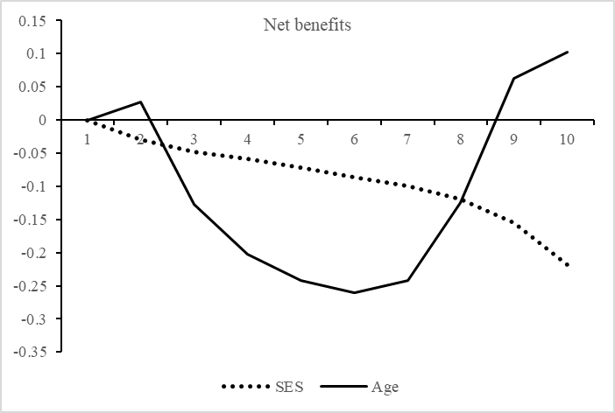
Coefficients of age and SES groups - Net benefit model
(reference category, age=0-9, SES=lowest status group)

Slide 17
Dispersion importance of age and income on benefits, taxes and net benefits (Shapley value decomposition)
Note: Without interaction: based on regression models including only age and SES dummies as explanatory variables. With interaction: based on regression models including age and SES dummies and interaction of age and SES as explanatory variables.

Slide 18
Conclusions
We confirmed that welfare programs are insensitive to status differences, while age has a sizeable effect on the access to the welfare system.
European social policy overall is better described as an inter-age transfer system than a public program alleviating poverty or mitigating inequality.
Social policies should not only be evaluated in terms of poverty alleviation but also in terms of age-related redistribution.
Example: targeting of pensions.
All forms of government intervention (e.g. safety regulations, infrastructure development, etc) affect poverty and inequality.
There is no reason why social policy, an inter-age project, is singled out to be responsible for poverty alleviation and mitigation of inequality.

Slide 19



Thank you for your attention!
This project has received funding from the European Union’s Seventh Framework Programme for research, technological development and demonstration under grant agreement no 613247 (Gál) and the Hungarian Science and Research Fund (OTKA K112900) (Medgyesi).

